Slide 1
KNOWLEDGE REPRESENTATION TECHNIQUES

Slide 2
Introduction
Different knowledge representation techniques: rules, semantics nets, frames, scripts, languages such as KL-1, KRYPTON, conceptual graphs, and others.
Those could be divided into three categories: logic representation, procedural representation, network representation, and structural representation.
Structural representation expands the network representation by defining the nodes having complex data structures. For example, script, frame, and object.

Slide 3
Object-Attribute-Value Triple
One problem with semantic nets is the lack of standard definitions for link names (IS-A, AKO, etc.)
The OAV triplet can be used to characterize all the knowledge in a semantic net. For example, the expert system MYCIN has used a semantic net for diagnosing infectious diseases.
The OAV triple representation lists knowledge in the form of a table.

Slide 4
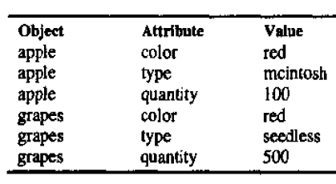

Slide 5
OAV triples are useful for representing facts and the patterns to match the facts in the antecedent of a rule.
The semantic net will have nodes for objects, attributes, and values connected by HAS-A, and IS-A links.
The semantic net then is easy to translate into PROLOG.

Slide 6
Frame
One type of schema is a frame (or script-time-ordered sequence of frames)
Frames are useful for simulating commonsense knowledge
Semantic nets provide 2-dimensional knowledge; frames provide 3-dimensional.
Frames represent related knowledge about narrow subjects having much default knowledge/

Slide 7
A frame is a group of slots and fillers that defines a stereotypical object that is used to represent generic/ specific knowledge.
Commonsense knowledge is the knowledge that is generally known.
Prototypes are objects possessing all typical characteristics of whatever is being modelled.
Problems with frames include allowing unrestrained alteration/cancellation of slots.

Slide 8
General frame structure:
Frame name _______________
Class name _______________
Properties:
Property Value (Property aka attribute)
________ _____
________ _____
________ _____
________ _____
________ _____

Slide 9
Frame name Bird
Super-Class name Animal(or vertebrate, etc.)
Properties:
Property Value (Property aka attribute)
Color Unknown
No-wings 2
Flies_ True
Hungry Unknown
Activity Unknown

Slide 10
Scripts
A knowledge representation scheme similar to a frame, but instead of describing an object, the script describes a sequence of events.
Portrays a stereotyped situation.
It is usually presented in a particular context.
The script uses a series of slots containing information about the events' people, objects, and actions involved.
Include entry conditions, props, roles, tracks, and scenes.

Slide 11
The entry conditions describe situations that must be satisfied before events in this script can occur or be valid.
Props refer to objects that are used in the sequence of events that occur.
Roles refer to the people involved in the script.
The result is conditions that exist after the events in the script have occurred.
Track refers to variations that might occur in a particular script.

Slide 12
Scenes describe the actual sequence of events that occur.
Useful in predicting what will happen in a specific situation.
Even though certain events have not been observed, the script permits the computer to predict what will happen to whom and when.
If the computer triggers a script, questions can be asked and accurate answers derived with little or no original input knowledge.

Slide 13
Useful because there are so many stereotypical situations and events that people use every day.
Knowledge is generally taken for granted, but in computer problem-solving situations, such knowledge must often be simulated to solve a particular problem using AI.
Knowledge is stored in the computer in symbolic form.
This is best done using LISP or another symbolic language.

Slide 14
Then the system can be asked questions about various persons and conditions.
A search and pattern-matching process examines the script for the answers.

Slide 15
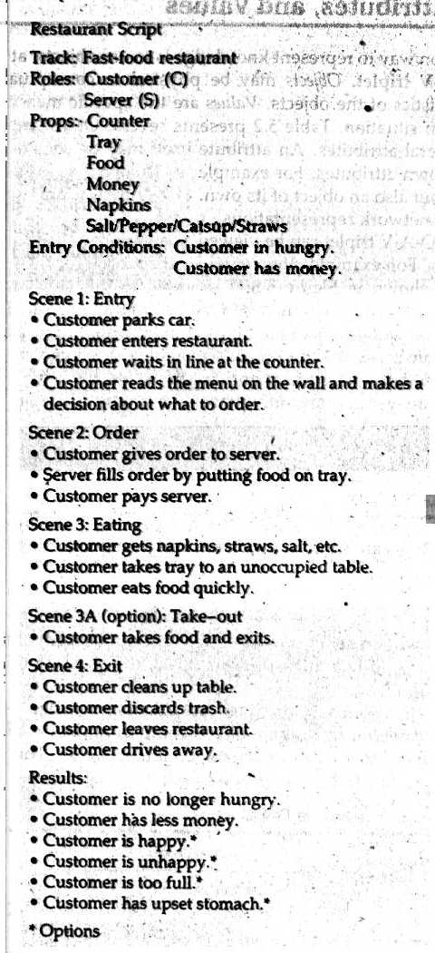

Slide 16
For example, what does the customer do first?
Well, he parks the car, then goes into the restaurant.
Whom does he pay?
The server, of course.
The whole thing is totally predictable.
Script representation is interrelated with case-based reasoning.

